Slide 1
SCHRODERS X READ ALLIANCE
SERVICE MANAGEMENT ALERTING PLATFORM
AUGUST 2019
Notes:
FAYE/ANDREW

Slide 2
DAY 1: GETTING STARTED
Introductions
Project outline
Business background
Technology overview
Intro to Raspberry Pi
Python
Circuits
Raspberry Pi circuit
Notes:
FAYE

Slide 3
INTRODUCTIONS
Name tags
Icebreaker: Who is it?
Everyone write a fun fact about themselves onto a slip of paper and put it into the hat. Each slip will be drawn one by one and the aim is to guess who is the person behind the fact. Once a person’s fact has been read aloud, they will pick the next fact from the hat.
Notes:
FAYE - EVERYONE HERE

Slide 4
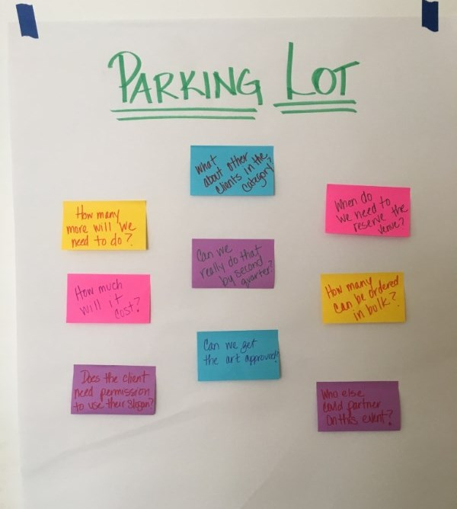
WORKSHOP OUTLINE
What will we be doing?
What will you learn about?
Raspberry Pis
Programming in Python
Project Management
Service Management
What do you want out these workshops?
Notes:
FAYE / ANDREW

Slide 5
BUSINESS BACKGROUND
Thom - what is your team responsible for? How do you know if something breaks?
What do you do today? How can this be improved?
For the group - what do you think can be done?
Notes:
THOM / ANDREW

Slide 6
WHAT IS A PROJECT?
What are examples of projects you’ve had to work on?
Did you like it? Why?
How do you define a project?
Notes:
ANDREW

Slide 7
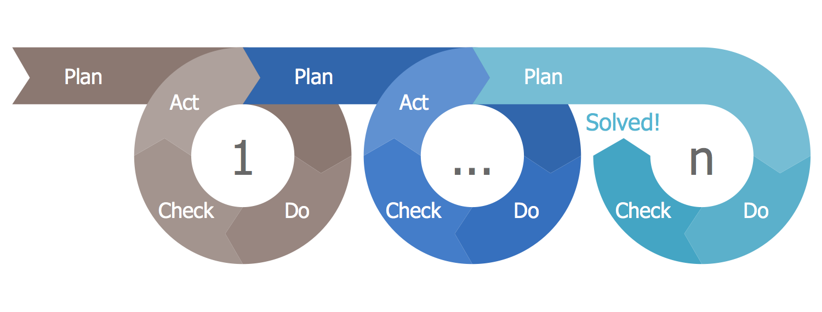
DOING A PROJECT
PLANNING
DOING
REVIEWING
What must be done?
What can be done?
What can we commit to do in the time given with the people and resources we have?
Agree to the scope
List what:
Is pending
Is being worked on
Is done
Blockers / Problems / Issues
Who is fixing these?
What did we expect to do?
Did we do it?
Was it “good enough?”
How can we improve?
Determine actions for improving
Notes:
ANDREW

Slide 8
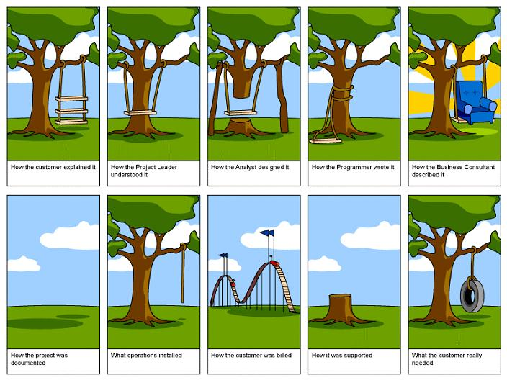
WHY UNDERSTANDING SCOPE IS IMPORTANT
Notes:
ANDREW

Slide 9
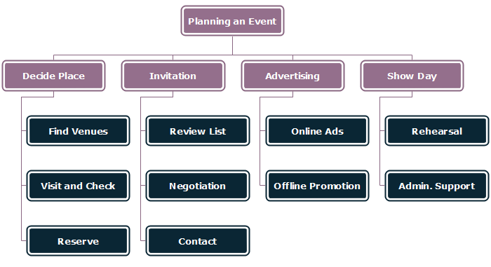
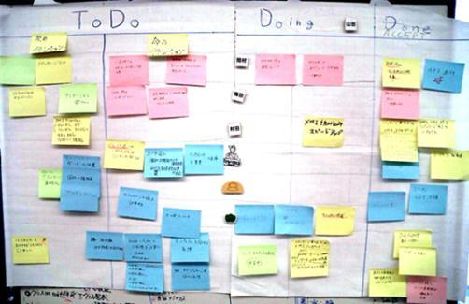
HOW TO DOCUMENT SCOPE
Let’s determine the scope of our Service Management Alert Project

Slide 10
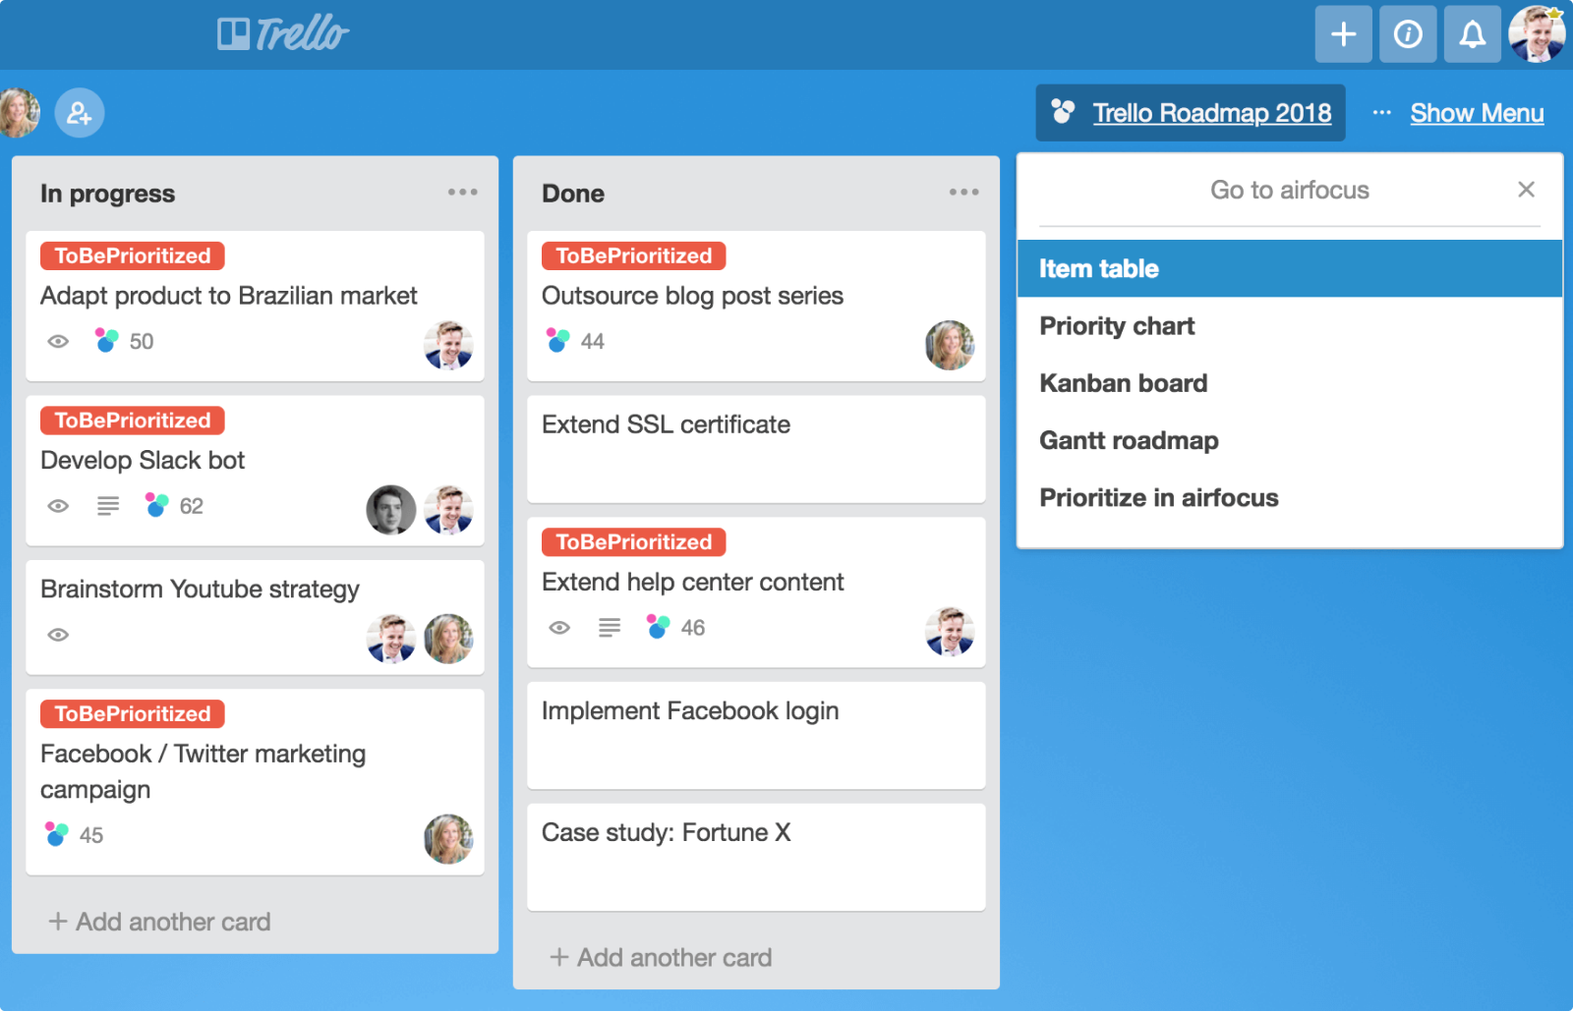
TRACKING TO COMPLETION
Each task must have:
Description
Sequence / Order
If needed, consider:
Due date
Assignment

Slide 11



TECHNOLOGY OVERVIEW
What will we need to build a simple alerting system?
Notes:
VLAD / KALPANA

Slide 12

CIRCUIT SYMBOLS
Notes:
KALPANA / FAYE

Slide 13



CIRCUIT DIAGRAMS
Notes:
KALPANA / FAYE

Slide 14
INTRO TO RASPBERRY PI
1) Plug in
2) Console
3) Blah blah blah
4) Clone the repo
Notes:
VLAD / KALPANA

Slide 15
RASPBERRY PI CIRCUIT
What will this look like? Draw the circuit diagram
Now build it!
Notes:
VLAD / KALPANA

Slide 16
Retrospective
Check the parking lot?
What did we learn?
What worked well?
What could we do better?

Slide 17
DAY 2: LET’S CODE!
Recap
Programming concepts
Functions
Comments
Variables
Error Handling
Create Email To Thom functionality
Send Email by Raspberry Pi
Notes:
FAYE / ANDREW

Slide 18
RECAP
What did we cover yesterday?
Notes:
FAYE / ANDREW

Slide 19
PYTHON
What is Python?
Opening the text editor
The first program: Hello World!
Notice the different colors of the words. Why is that?
Running programs
Notes:
FAYE / KALPANA

Slide 20
PROGRAMMING BASICS
Keywords – which keyword have we already come across?
Strings / Numbers – how can you tell the difference?
Variables – why would you need these?
Comments – why would you need these?
Notes:
FAYE / KALPANA

Slide 21
PROGRAMMING FUNCTIONS
How do you write a function?
How do you call a function?
How do you use parameters within functions? And why would you want to?
How do you return values from functions? And why would you want to?
Q: What is the difference between a variable, a parameter and a value?
Notes:
ANDREW / SAMI

Slide 22
IMPORTING LIBRARIES
What is a library?
Why would you want to use one?
Where is this code stored?
Can you build your own?
Notes:
ANDREW / SAMI

Slide 23
RASPBERRY PI SOFTWARE
1) Copy source code
2) Run the code
3) Explain it
4) Change the code so the light remains on for 5 seconds after pushing button
5) Test it
Notes:
JOSH / VLAD

Slide 24
SEND AN EMAIL
Review and edit the code
To: Thom.Christensen@Schroders.com
Subject: Sending a test email from my raspberry pi
Body: Make something up!
Test it
Embed the code into a function
Test it
Notes:
JOSH /VLAD

Slide 25
BUILD A CLASS
What is a class?
Why would we use classes?
How would you use classes?
What is Object Oriented Programming (OOP)?
Notes:
ANDREW / KALPANA

Slide 26
ENHANCED SEND AN EMAIL
Take your email function and put it in a class
Add functionality to push button to turn on light and send the email when button is pressed
Count the number of times the button is pressed
Save the number of times the button is pressed between reboots
Notes:
SAMI / FAYE

Slide 27
Retrospective
Check the parking lot?
What did we learn?
What worked well?
What could we do better?

Slide 28
DAY 3: WORKING WITH THE BUSINESS
The basics of Service Management
Introduction to ServiceNow
Send an alert to ServiceNow
Reporting on issues
Device Registration
Ticket validation / Preventing Spam
Notes:
ANDREW

Slide 29
RECAP
Notes:
ANDREW

Slide 30
SERVICE MANAGEMENT
Why is this needed?
What does ServiceNow do?
What is the issue lifecycle?
How do we send an alert to ServiceNow?
Notes:
CHRIS / THOM

Slide 31
IDENTIFYING UNIQUE DEVICES
If we placed each device in a different location, how could we tell which button was pressed to trigger an alert?
Notes:
JOSH / VLAD

Slide 32
SEND EMAILS TO SERVICENOW
Notes:
ANDREW / CHRIS

Slide 33
REPEATED TICKETS
Scenario 1: One person notices the coffee machine is broken and presses the button. A second person does the same, and a third person. All within five minutes. Three tickets are raised for one incident.
Scenario 2: One person notices the coffee machine is broken. They really want coffee. They press the button repeatedly twenty times. Twenty tickets are raised for one incident.
Q: How would we avoid these scenarios?
Notes:
KALPANA / SAMI

Slide 34
Retrospective
Check the parking lot?
What did we learn?
What worked well?
What could we do better?

Slide 35
DAY 4: MATURING THE MODEL
Using the Cloud to create ServiceNow tickets
Reporting
Wrapping up
Other things you can do with a Raspberry Pi
Participant Feedback
Notes:
ANDREW

Slide 36
RECAP
Notes:
ANDREW

Slide 37
AZURE
Why use back end system instead of emailing directly?
How do we talk to the back end system?
What is the cloud?
Update the Raspberry Pi to talk to the API to raise a ticket in ServiceNow
Notes:
JOSH /VLAD

Slide 38
REPORTING
Where do you see reporting in your everyday life?
Why is it important?
What does bad/good reporting look like?
What do we want to learn from ServiceNow data
Create your own data visualizations
Notes:
KALPANA /FAYE

Slide 39
OTHER PROJECTS
Alien Invasion
Kodi Media Center
Steam link – stream your PC games to your TV
Alexa: Build your own Amazon Echo/ Google assistant
Pi-hole – network wide ad-blocker
Adafruit for more accessories
Notes:
FAYE / ANDREW

Slide 40
THANK YOU
Thank you for taking part in our first collaboration with Read Alliance.
Please provide any feedback on the forms provided.
Notes:
ANDREW / FAYE

